Slide 1

TITRE DE LA PRÉSENTATION
Student classification using Logistic Regression, Random Forest and XGBoost
Alexandre Chauvin
OGTIP Data Science Batch 2023
Project 3
Steven Lomon Lennartsson

Slide 2
AGENDA
Introduction
The dataset and Aim
Data Pre-processing and Cleaning
Splitting, standardizing and fitting the data
Feature selection
Hyperparameter Tuning
Threshold Selection and ROC Curve
Model comparison
Predictions and Mini-EDA of the results
Summary

Slide 3

INTRODUCTION
We are given limited student data from a reputed university that include relevant information of students from the university, such as nationality, their curricular unit data, and whether they are scholarship holders or not. Using this dataset, we will build five different machine learning models with the aim of predicting whether currently enrolled students will graduate or drop out.
The project is done entirely in Google Colab. All classifiers are from the Scikit-learn library except XGBoost. All scoring metrics, the train_test_split, and other machine learning tools are from Scikit-learn, and a few things from the scipy-stats library are also used.

Slide 4
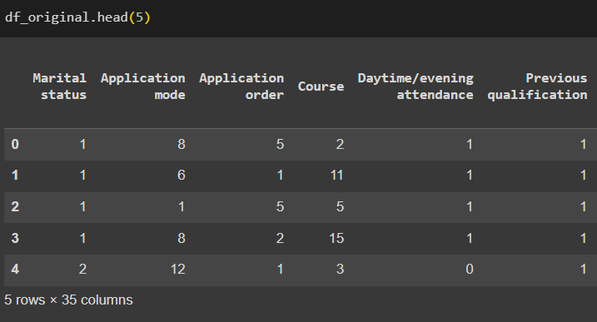
The Dataset and aim
The full dataset contains 4424 rows and has a total of 35 columns. A full list will be shown on the next slide. The first five rows with the first six columns are shown to the left.
We once again have a lot of data! But this is needed for Machine Learning. We will do predictions using the following five classifiers:
Logistic Regression
Random Forest
Gaussian Naive Bayes
Linear Support Vector Classification
XGBoost
We will compare the accuracy of these five models, aiming for over 90% for all of them, and do our best to gain insights from their results. For every classifier we will follow the pipeline below:
Splitting, standardizing and fitting the data -> Feature selection -> Hyperparameter tuning
-> Threshold selection -> Predicting

Slide 5
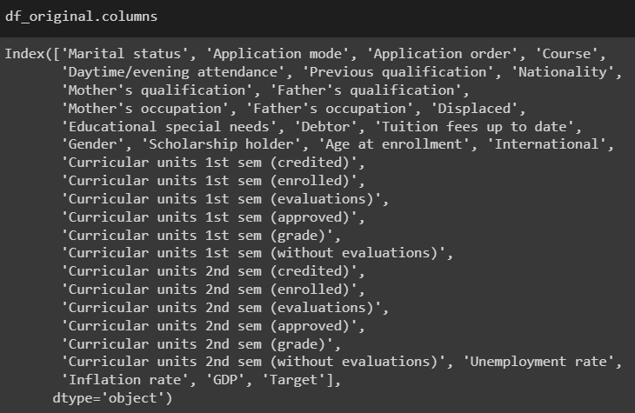
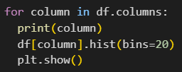
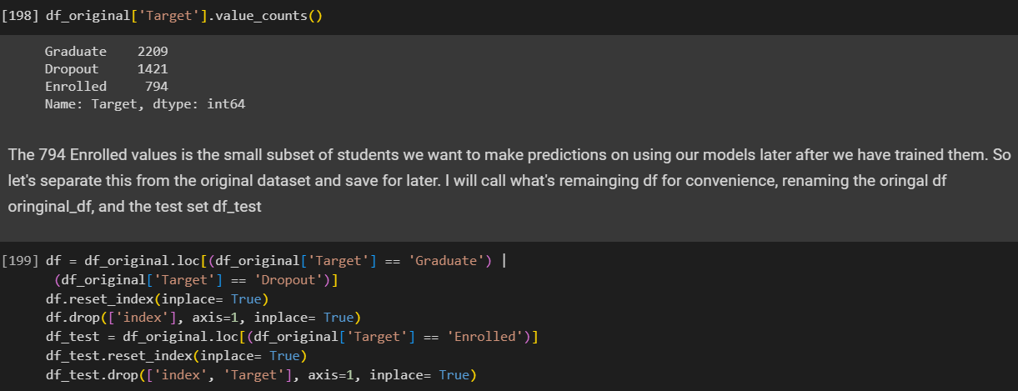
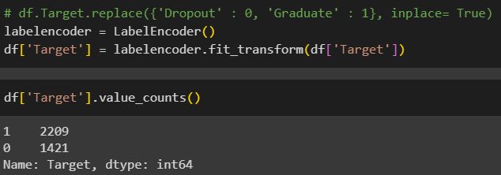
Data pre-processing and cleaninG
The data was relatively clean so not too much pre-processing or cleaning was needed. Since all of the categotical columns were numerical except the Target column, that was the only one we needed to use LabelEncoder on. The most important thing we did in this was separating the Enrolled values on the Target column into ints own separate dataframe that we later on will do predictions on. I visualized all of the data with a simple loop and there are outliers but since we don’t know what the numbers mean (we are given a Specification of Data but there is no description of all the
numbers infor the Curricular units data), I
decided to keep all of the data to have as
much as possible for the classifiers.

Slide 6
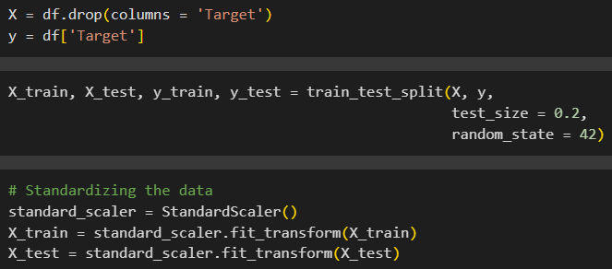
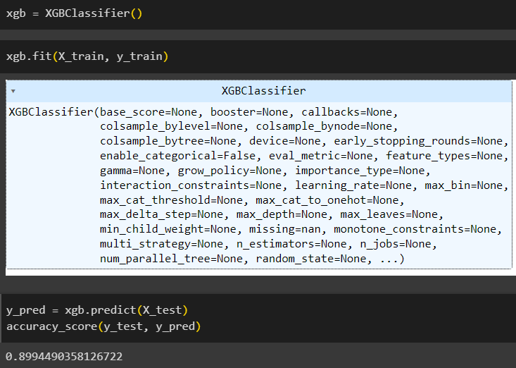
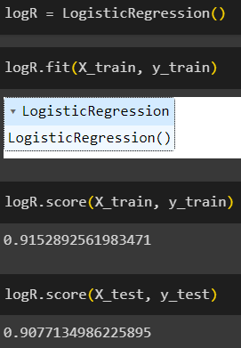
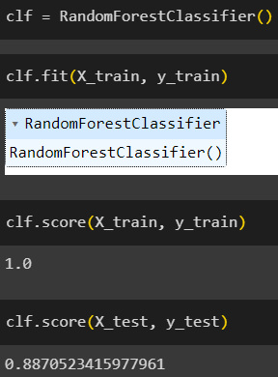
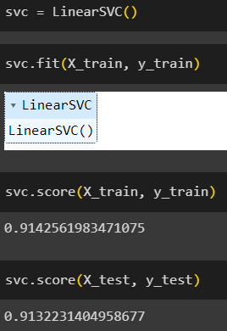
Splitting, standardizing and fitting the data
All five models have the same lines of code to split the data into a train/test split and standardizing it, shown to the right. I am choosing to use an 80/20 split: 80% to train the data and 20% to test it against the actual values.
Below are the different ways (Gaussian NB not shown) in which we fit the X_train and y_train to the classifier with all their standard values to get our first train score and test score that we will aim to improve with the upcoming steps of the pipeline. As we can see by the train score of the Random Forest classifier, it is clearly overfitted which needs to be taken care of.

Slide 7
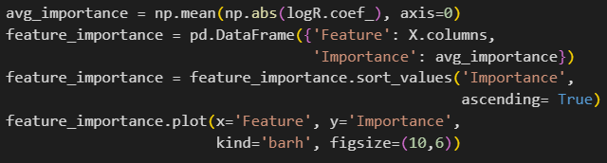
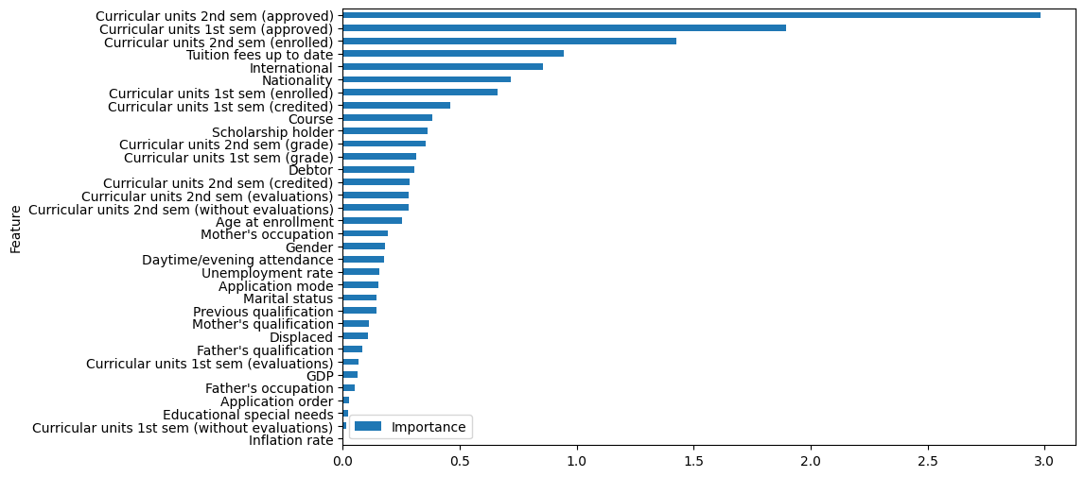
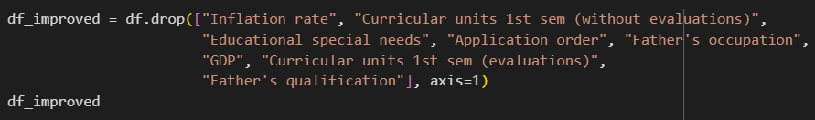
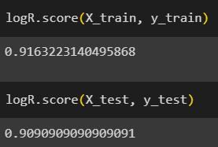
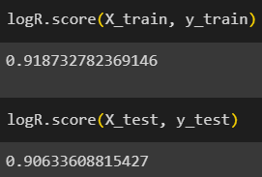
Feature selection I
This stage involves looking at the feature importance of each classifier and see if we can remove some features (columns in the dataframe) in order to make sure the data isn’t get trained on irrelevant data and make it more efficient. The Gaussian NB Classifier and the Linear SVC Classifier don’t have feature importance in the general sense like the three others have so I have skipped this step for those two. For all our models that has intrinsic feature importance (more on this next slide), the baseline scores we got in the previous stage are improved after the feature selection! I am only showing the process and
code for our Logistic Regression model here. For this one in particular, I
tried removing even more feautres than shown here but that actually
lowered the test score (the score to the right) so there is a fine balance
when it comes to removing features.

Slide 8
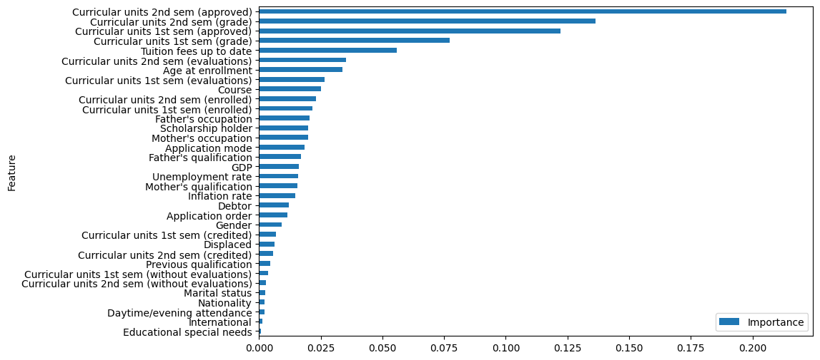
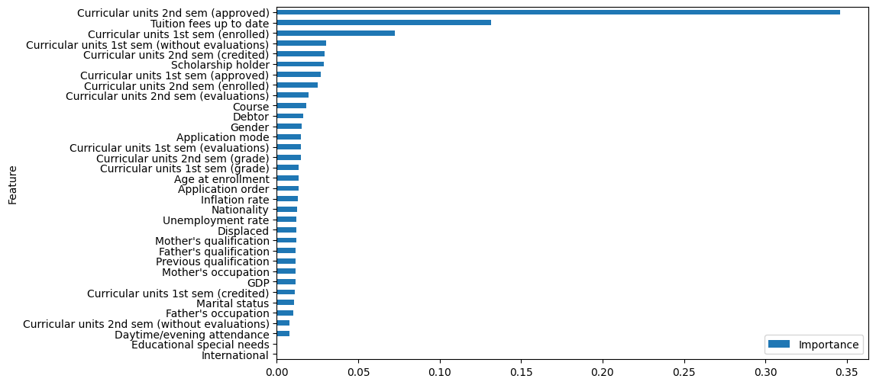
Feature selection ii
Here are the feature importances for the three classifiers that intrinsically have them; Logistic Regression, Random Forest and XGBoost. We can see that all three classifiers are unanimous in that having passed the 2nd Semester Currcicular Units is the singlehandedly most important factor when it comes to graduating! To the right is Random Forest, lower left is Logistic Regression and lower right is XGBoost. There are ways of viewing the equivalence of feature importance for Gaussian NB and Linear SVC, but I chose to not prioritize that

Slide 9
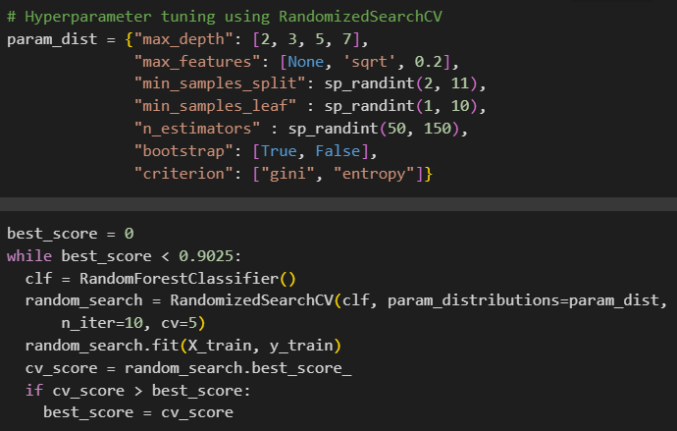
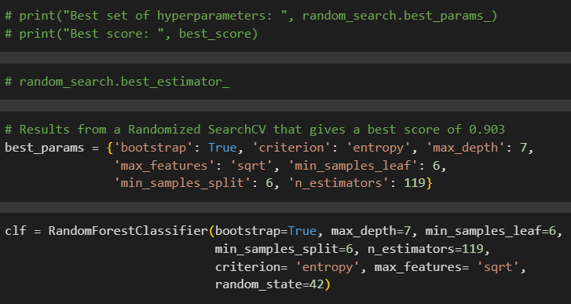
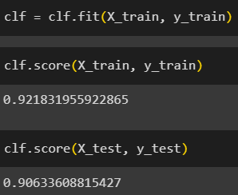
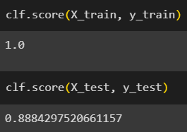
Hyperparameter tuning
I have chosen to use RandomizedSearchCV for Hyperparameter tuning in all cases for this stage. It simply involes finding the optimal parameters for our classifiers for this specific problem statement and this specific set of data. Once again here however with Gaussian NB and Linear SVC; Gaussian NB only have two parameters to tune and the RandomizedSearchCV for Linear SVC did not give any meaningful results. So they are not shown here and were essentially skipped in the pipeline once again.
In the case of our Logistic Regression classifier, the hyperparameter actually lowered the test score! So instead, I have chosen to highlight the process and code for the Random Forest classifier, where once again, this stage is essential to remove the overfitting. Not only did we remove it, we increased the test score by ca 7%! (The score from after feature selection is to the left)
The hyperparameter tuning for XGBoost is by far the most complicated because of how many parameters it has, and
it is something that
can definitely be
improved for this
project.

Slide 10
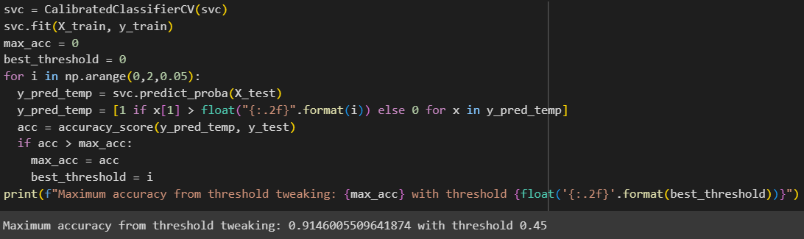
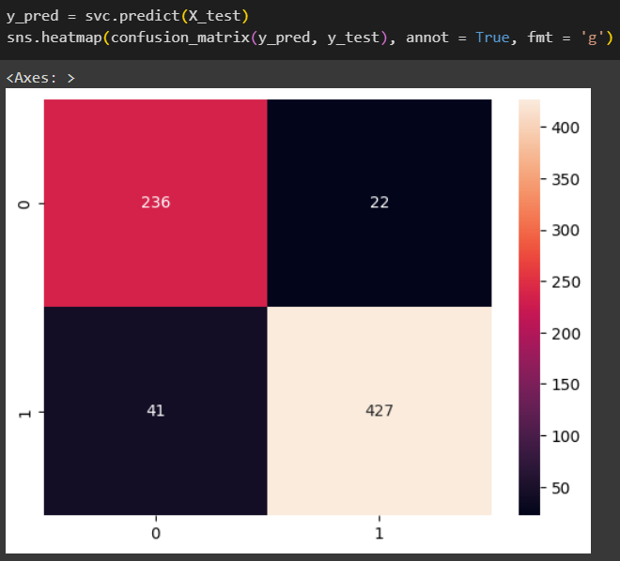
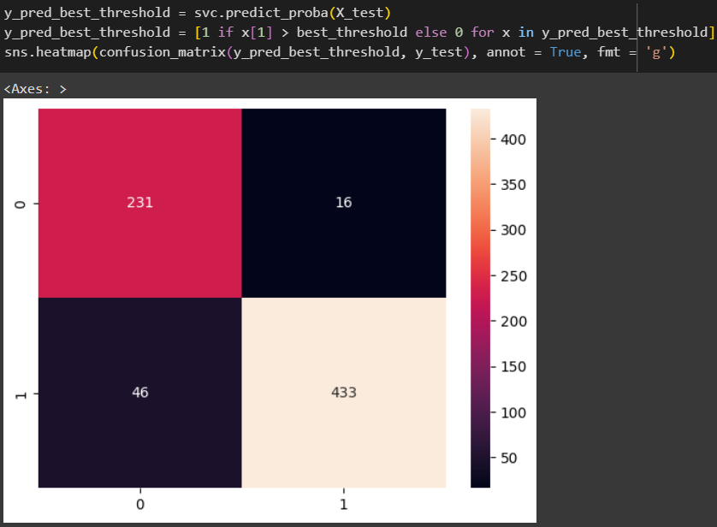
Threshold selection and the roc curve I
In this stage, we are looking at the predictions that the classifiers we have built so far gives and we compare it to the solution (the actual values) to see where it goes wrong. All of this is visualized in a Confusion Matrix that shows the distribution of the correct predictions in the True Positives and True Negatives, as well as the wrong predictions in the False Positives (Type I Error) and False Negatives (Type II Error). I have chosen to highlight Linear SVC here. What’s interesting
is that with the optimal
threshold, we often
sacrifice a few correct
predictions for Drop out
(0) in order to get more
correct predictions for
Graduation (1).

Slide 11
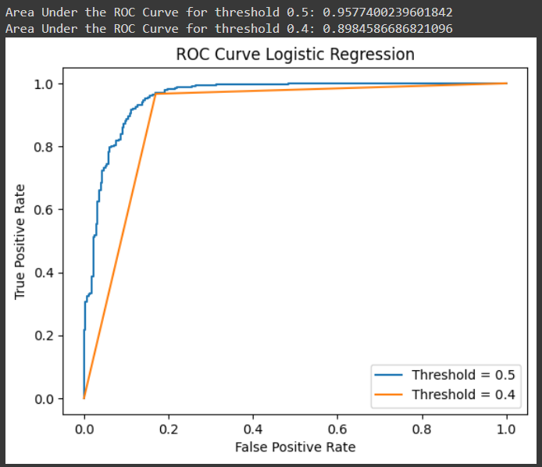
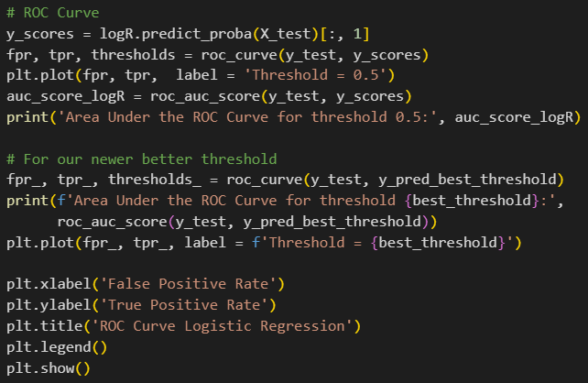
Threshold selection and the roc curve II
With this optimal threshold changing the way our classifiers distributes the 0s and 1s in our resulting output, we have our final models! The classification models for all 5 will be shown in the next slide.
For all five, we are also drawing a Receiver Operator Characteristic (ROC) curve. It is simply a curve that shows the trade-off between sensitivity and specificity; plotting the True Positive Rate against the False Positive Rate. A curve that operates up towards the top left corner is generally better. We want the AUC (Area Under the Curve) value to be as low as possible
I must admit here, I do not fully understand this code haha

Slide 12
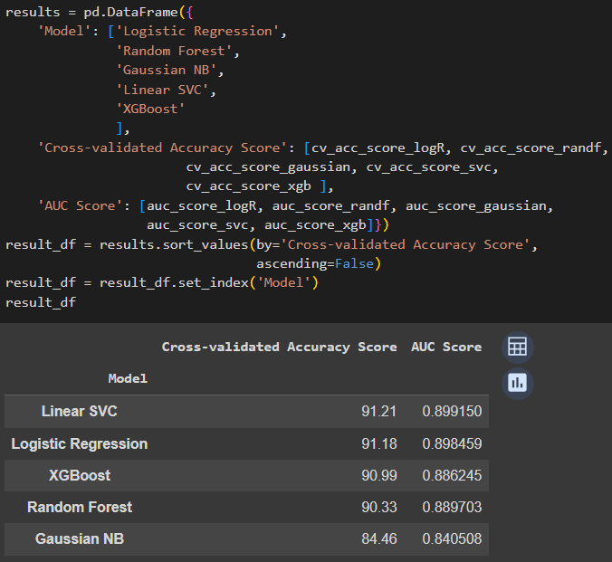
Model comparison
Here are the full results from all of our model building:
I do feel that XGBoost could be the best performing model if I took more time to dive deep and research all of its parameters for the Hyperparameter tuning
The only model that was not able to reach 90% accuracy was Gaussian NB. I do feel that this is once again part the classifier, part me not giving it enough research
As always with Machine Learning models and classifiers, we can pour time and resources into hyper optimizing our scores, but we must eventually reach a point where we declare “This is it, this is good enough”
With this in mind; we will now look at the predictions that our models have made!

Slide 13
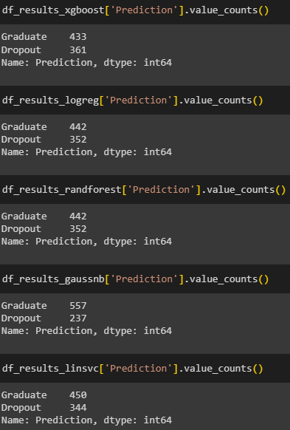
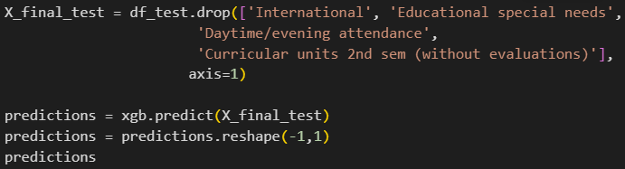
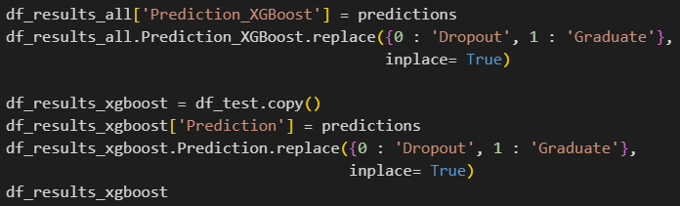
Predictions and mini-eda of the results I
For this final stage, we first drop the same features that we dropped when training the model from the subset dataset we put aside in the beginning. We add the predictions as a column in the dataset as a new separate dataset for each classifier, and we revert the LabelEncoder by mapping 0 to Dropout and 1 to Graduate.
As we can see to the right, our Logistic Regression model and our Random Forest model give the same ratio in its predictions! This is something that I allowed my curiosity to explore, which will be shown in the next slide

Slide 14
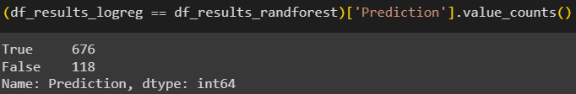
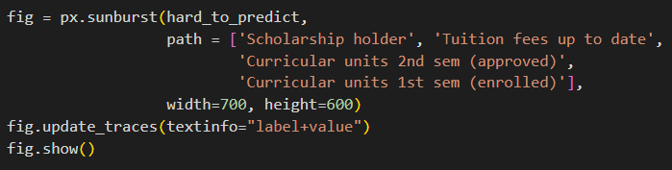
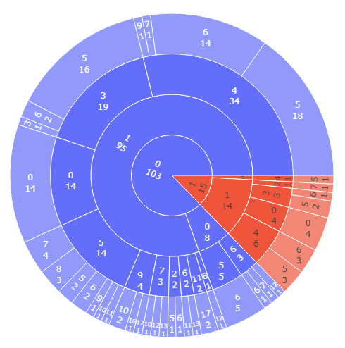
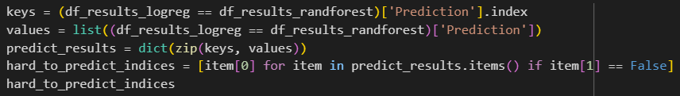

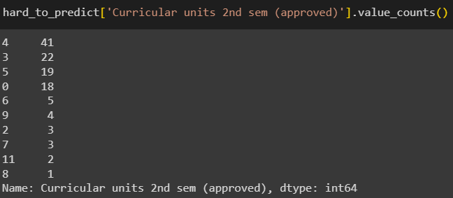



Predictions and mini-eda of the results II
Going down this little rabbit hole, we see that the ratio of predictions is exactly the same but there are 118 predictions that are different between the two models!
I chose to examine these 118 students and see if we can find what makes them so hard to predict. This is outside the problem statement of the project but I value curiosity and I allowed my self to see where it would lead me and I’m sharing my results. We do not know what the Curricular Units numbers represent (they are not even in the Specification of Data we are given), but we can see that one factor is that most of them are not scholarship holders but their tuition fees are up to date; a clash of two factors that all classifiers agreed were important. The singlehandedly most
important factor is also very spread out and varied.
Even more optional exploration of the results are in the notebook, including a look
at the oldest student in the dataset at 70 years old. Massive kudos to him!

Slide 15
SUMMARY and reflection
So are we able to build a Machine Learning model to predict whether or not a student will graduate or drop out? With 4 models with over 90% accuracy; it seems so!
Linear SVC ended up being the best model by ca 0.3%, Logistic Regression being just ever so slightly behind. Gaussian NB ended up being the worst and the only one that didn’t reach 90% accuracy. While I do feel I could have put in more time researching parameters and optimizing, I also immediately noticed the low baseline test score, hyperparameter tuning didn’t lead anywhere, and I feel it’s important to know when to stop. This simply wasn’t its time to shine.
Whether or not they have passed the exams in the second semster ended up being the most important factor, and this makes a lot of sense. Other factors that all classifiers agreed were important were whether or not they are enrolled in all classes of the 1st semester, whether or not they were scholarship holders and whether or not their tuition fees are up to date. At the same time, I do very much believe it is possible to graduate without a scholarship, with tuition fees not up to date, and failing the exams of the 2nd semester the first time around! Don’t let a machine prediction set your faith in stone! It is also pleasant to see that Educational special needs is at the bottom of importance when it comes to predicting for all three models, and Gender plays a very minimal part as well.
Sharing my own experience as someone that has dropped out of university twice, the most important factor is passing the exams, yes. And one of - if not the most - important cornerstones in order to actually pass exams is good mental health, which can’t really be quantifiable for a Machine Learning model. Yes, it is fully possible to pass exams without consistent quality sleep, rarely getting exercise, and not having a strong support net. But it’s seldom fulfilling when you do finally ”win”.
To anyone reading this; take care of yourself
Thank you!

